Slide 1
Cornerstone City Church Peninsula Plus Community Hoo Are Ya 20-03-2022

Slide 2
Million Little Miracles
CCLI Song # 7171580
Brandon Lake | Chris Brown | Steven Furtick
© 2021 Music by Elevation Worship Publishing (Admin. by Essential Music Publishing LLC)
Bethel Music Publishing (Admin. by Song Solutions)
Brandon Lake Music (Admin. by Song Solutions)
Maverick City Publishing Worldwide (Admin. by Song Solutions)
For use solely with the SongSelect® Terms of Use. All rights reserved. www.ccli.com
CCLI Licence No. 33265

Slide 3
1/7
All my life I've been carried by grace
Don't ask me how 'cause I can't explain
It's nothing short of a miracle I'm here
I've got some blessings that I don't deserve
I've got some scars but that's how you learn
It's nothing short of a miracle I'm here

Slide 4
2/7
I think it over and it doesn't add up
I know it comes from above

Slide 5
3/7
(I've got) miracles on miracles
A million little miracles
Miracles on miracles
Count your miracles
1-2-3-4 I can't even count 'em all

Slide 6
4/7
You held me steady so I wouldn't give up
You opened doors that nobody could shut
I hope I never get over what You've done
I wanna live with an open heart
I wanna live like I know who You are
I hope I never get over what You've done

Slide 7
5/7
It's not coincidence and it's not luck
I know it comes from above

Slide 8
6/7
(I've got) miracles on miracles
A million little miracles
Miracles on miracles
Count your miracles
1-2-3-4 I can't even count 'em all

Slide 9
7/7
I can't even I can't even count 'em all
I can't even I can't even count 'em all
I can't even I can't even count 'em all 1-2-3-4 I can't even count 'em all

Slide 10
Goodness Of God
CCLI Song # 7117726
Ben Fielding | Brian Johnson | Ed Cash | Jason Ingram | Jenn Johnson
© 2018 Capitol CMG Paragon (Admin. by Capitol CMG Publishing)
Fellow Ships Music (Admin. by Essential Music Publishing LLC)
So Essential Tunes (Admin. by Essential Music Publishing LLC)
SHOUT! Music Publishing Australia (Admin. by SHOUT! Music Publishing UK)
Bethel Music Publishing (Admin. by Song Solutions)
For use solely with the SongSelect® Terms of Use. All rights reserved. www.ccli.com
CCLI Licence No. 33265

Slide 11
1/4
I love You Lord
Oh Your mercy never fails me
All my days
I've been held in Your hands
From the moment that I wake up
Until I lay my head
I will sing of the goodness of God

Slide 12
2/4
All my life You have been faithful
All my life You have been so so good
With every breath that I am able
I will sing of the goodness of God

Slide 13
3/4
I love Your voice
You have led me through the fire
In darkest night
You are close like no other
I've known You as a father
I've known You as a friend
I have lived in the goodness of God

Slide 14
4/4
Your goodness is running after
It’s running after me
Your goodness is running after
It’s running after me
With my life laid down
I’m surrendered now
I give You everything
Your goodness is running after
It's running after me

Slide 15
Here For You
CCLI Song # 5925649
Jesse Reeves | Matt Maher | Matt Redman | Tim Wanstall
© 2011 Chrysalis Music Ltd. (Admin. by BMG Rights Management (US) LLC)
sixsteps Music (Admin. by Integrity Music Ltd)
Thankyou Music (Admin. by Integrity Music Ltd)
Valley Of Songs Music (Admin. by Integrity Music Ltd)
worshiptogether.com songs (Admin. by Integrity Music Ltd)
For use solely with the SongSelect® Terms of Use. All rights reserved. www.ccli.com
CCLI Licence No. 33265

Slide 16
1/6
Let our praise be Your welcome
Let our songs be a sign
We are here for You
We are here for You
Let Your breath come from heaven
Fill our hearts with Your life
We are here for You
We are here for You

Slide 17
2/6
To You our hearts are open
Nothing here is hidden
You are our one desire
You alone are holy
Only You are worthy
God let Your fire fall down

Slide 18
3/6
Let our shout be Your anthem
Your renown fill the sky
We are here for You
We are here for You
Let Your Word move in power
Let what's dead come to life
We are here for You
We are here for You

Slide 19
4/6
Let it fall
Let it fall
Let it fall

Slide 20
5/6
We welcome You with praise
We welcome You with praise
Almighty God of love
Be welcome in this place
(REPEAT)

Slide 21
6/6
Let ev'ry heart adore
Let ev'ry soul awake
Almighty God of love
Be welcome in this place
We welcome You with praise
We welcome You with praise
Almighty God of love
Be welcome in this place

Slide 22
Holy Spirit
CCLI Song # 6087919
Bryan Torwalt | Katie Torwalt
© 2011 Capitol CMG Genesis (Admin. by Capitol CMG Publishing)
Jesus Culture Music (Admin. by Capitol CMG Publishing)
For use solely with the SongSelect® Terms of Use. All rights reserved. www.ccli.com
CCLI Licence No. 33265

Slide 23
1/4
There's nothing worth more that will ever come close
No thing can compare You're our living hope
Your Presence

Slide 24
2/4
I've tasted and seen of the sweetest of loves
Where my heart becomes free and my shame is undone
In Your Presence Lord

Slide 25
3/4
Holy Spirit You are welcome here
Come flood this place and fill the atmosphere
Your glory God is what our hearts long for
To be overcome by Your Presence Lord

Slide 26
4/4
Let us become more aware of Your Presence
Let us experience the glory of Your goodness (Lord)

Slide 27
O Come To The Altar
CCLI Song # 7051511
Chris Brown | Mack Brock | Steven Furtick | Wade Joye
© 2015 Music by Elevation Worship Publishing (Admin. by Essential Music Publishing LLC)
For use solely with the SongSelect® Terms of Use. All rights reserved. www.ccli.com
CCLI Licence No. 33265

Slide 28
1/5
Are you hurting and broken within
Overwhelmed by the weight of your sin
Jesus is calling
Have you come to the end of yourself
Do you thirst for a drink from the well
Jesus is calling

Slide 29
2/5
O come to the altar
The Father's arms are open wide
Forgiveness was bought with
The precious blood of Jesus Christ

Slide 30
3/5
Leave behind your regrets and mistakes
Come today there's no reason to wait
Jesus is calling
Bring your sorrows and trade them for joy
From the ashes a new life is born
Jesus is calling

Slide 31
4/5
Oh what a Savior
Isn't he wonderful
Sing alleluia Christ is risen
Bow down before him
For he is Lord of all
Sing alleluia Christ is risen

Slide 32
5/5
Bear your cross as you wait for the crown
Tell the world of the treasure you've found

Slide 34


Slide 35


Slide 36


Slide 37


Slide 38
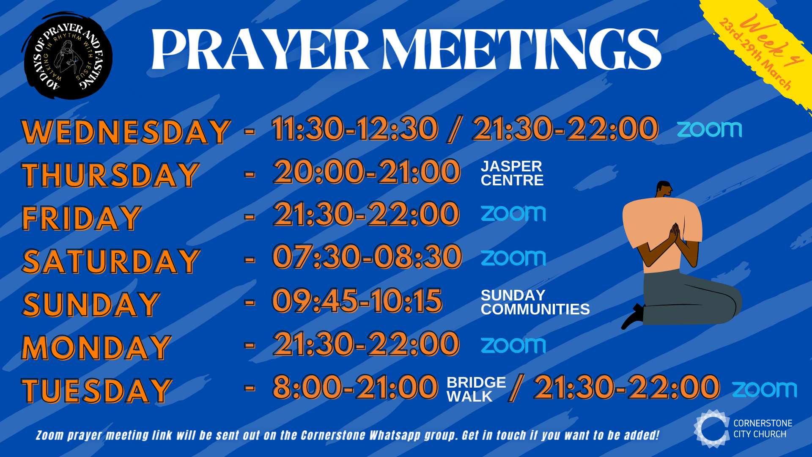

Slide 39


Slide 40


Slide 41


Slide 42


Slide 43


Slide 44


Slide 45


Slide 47
Hills And Valleys
CCLI Song # 7060141
Chuck Butler | Jonathan Smith | Tauren Wells
© Be Essential Songs (Admin. by Essential Music Publishing LLC)
Cashagamble Jet Music (Admin. by Essential Music Publishing LLC)
Crucial Music Entertainment (Admin. by Essential Music Publishing LLC)
Hipgnosis Songs Essential (Admin. by Essential Music Publishing LLC)
Jord A Lil Music (Admin. by Essential Music Publishing LLC)
So Essential Tunes (Admin. by Essential Music Publishing LLC)
For use solely with the SongSelect® Terms of Use. All rights reserved. www.ccli.com
CCLI Licence No. 33265

Slide 48
1/9
I've walked among the shadows
You wiped my tears away
I've felt the pain of heartbreak
And I've seen the brighter days
And I've prayed prayers to heaven
From my lowest place
And I have held Your blessings
God You give and take away

Slide 49
2/9
No matter what I have Your grace is enough
No matter where I am I'm standing in Your love

Slide 50
3/9
On the mountains I will bow my life
To the one who set me there
In the valley I will lift my eyes
To the one who sees me there
When I'm standing on the mountain
I didn't get there on my own
When I'm walking through the valley
I know I am not alone

Slide 51
4/9
You’re God of the hills and valleys
Hills and valleys
God of the hills and valleys
And I am not alone

Slide 52
5/9
I've watched my dreams get broken
In You I hope again
No matter what I know
I’m safe inside Your hands

Slide 53
6/9
Father You give and take away
Every joy and every pain
Through it all You will remain over it all
(REPEAT) On the mountains I will bow my life
In the valley I will lift my eyes

Slide 54
7/9
God of the hills
The God of the valleys
God of the hills and valleys
And I am not alone

Slide 55
8/9
On the mountains I will bow my life
To the one who set me there
In the valley I will lift my eyes
To the one who sees me there
When I'm standing on the mountain
I didn't get there on my own
When I'm walking through the valley
I know I am not alone

Slide 56
9/9
You’re God of the hills and valleys
Hills and valleys
God of the hills and valleys
And I am not alone

Slide 57
Draw me close
CCLI Song # 1459484
Kelly Carpenter
© 1994 Mercy / Vineyard Publishing (Admin. by Integrity Music Ltd)
For use solely with the SongSelect® Terms of Use. All rights reserved. www.ccli.com
CCLI Licence No. 33265

Slide 58
1/2
Draw me close to You never let me go
I lay it all down again
To hear You say that I'm Your friend
You are my desire no one else will do
'Cause nothing else could take Your place
To feel the warmth of Your embrace
Help me find the way bring me back to You

Slide 59
2/2
You're all I want
You're all I've ever needed
You're all I want
Help me know You are near

Slide 60
Oceans
(Where Feet May Fail)
CCLI Song # 6428767
Joel Houston | Matt Crocker | Salomon Ligthelm
© 2012 Hillsong Music Publishing Australia (Admin. by Hillsong Music Publishing UK)
For use solely with the SongSelect® Terms of Use. All rights reserved. www.ccli.com
CCLI Licence No. 33265

Slide 61
1/5
You call me out upon the waters
The great unknown where feet may fail
And there I find You in the mystery
In oceans deep my faith will stand

Slide 62
2/5
And I will call upon Your name
And keep my eyes above the waves
When oceans rise
My soul will rest in Your embrace
For I am Yours and You are mine

Slide 63
3/5
Your grace abounds in deepest waters
Your sov'reign hand will be my guide
Where feet may fail and fear surrounds me
You've never failed and You won't start now

Slide 64
4/5
Spirit lead me where my trust is without borders
Let me walk upon the waters
Wherever You would call me
Take me deeper than my feet could ever wander
And my faith will be made stronger
In the presence of my Saviour

Slide 65
5/5
I will call upon Your name
Keep my eyes above the waves
My soul will rest in Your embrace
I am Yours and You are mine

Slide 66
What a Beautiful Name
CCLI Song # 7068424
Ben Fielding | Brooke Ligertwood
© 2016 Hillsong Music Publishing Australia (Admin. by Hillsong Music Publishing UK)
For use solely with the SongSelect® Terms of Use. All rights reserved. www.ccli.com
CCLI Licence No. 33265

Slide 67
1/7
You were the Word at the beginning
One with God the Lord Most High
Your hidden glory in creation
Now revealed in You our Christ

Slide 68
2/7
What a beautiful Name it is
What a beautiful Name it is
The Name of Jesus Christ my King
What a beautiful Name it is
Nothing compares to this
What a beautiful Name it is
The Name of Jesus

Slide 69
3/7
You didn't want heaven without us
So Jesus You brought heaven down
My sin was great Your love was greater
What could separate us now

Slide 70
4/7
What a wonderful Name it is
What a wonderful Name it is
The Name of Jesus Christ my King
What a wonderful Name it is
Nothing compares to this
What a wonderful Name it is
The Name of Jesus

Slide 71
5/7
Death could not hold You
The veil tore before You
You silence the boast of sin and grave
The heavens are roaring
The praise of Your glory
For You are raised to life again

Slide 72
6/7
You have no rival
You have no equal
Now and forever God You reign
Yours is the kingdom
Yours is the glory
Yours is the Name above all names

Slide 73
7/7
What a powerful Name it is
What a powerful Name it is
The Name of Jesus Christ my King
What a powerful Name it is
Nothing can stand against
What a powerful Name it is
The Name of Jesus

Slide 74
Jireh
CCLI Song # 7164826
Chandler Moore | Chris Brown | Naomi Raine | Steven Furtick
© Chandler Moore Designee (Admin. by Capitol CMG Publishing)
Music by Elevation Worship Publishing (Admin. by Essential Music Publishing LLC)
Heritage Worship Music Publishing (Admin. by Song Solutions)
Maverick City Publishing (Admin. by Song Solutions)
Naomi Raine Music (Admin. by Song Solutions)
For use solely with the SongSelect® Terms of Use. All rights reserved. www.ccli.com
CCLI Licence No. 33265

Slide 75
1/7
I'll never be more loved than I am right now
Wasn't holding You up
So there's nothing I can do to let You down
It doesn't take a trophy to make You proud
I'll never be more loved than I am right now

Slide 76
2/7
Going through a storm but I won't go down
I hear Your voice carried in the rhythm of the wind
To call me out
You would cross an ocean so I wouldn't drown
You've never been closer than You are right now

Slide 77
3/7
Jireh You are enough
Jireh You are enough
I will be content in every circumstance
Jireh You are enough Forever enough
Always enough
More than enough

Slide 78
4/7
I don't wanna forget how I feel right now
On the mountaintop
I can see so clear what it's all about
Stay by my side when the sun goes down
Don't wanna forget how I feel right now

Slide 79
5/7
I'm already loved
I'm already chosen
I know who I am
I know what You've spoken
I'm already loved
More than I could imagine
And that is enough

Slide 80
6/7
If He dresses the lilies with beauty and splendor
How much more will He clothe you
How much more will He clothe you
If He watches over every sparrow
How much more does He love you
How much more does He love you

Slide 81
7/7
More than you ask think or imagine
According to His power Working in us How much more does He love you

Slide 82
Reckless Love
CCLI Song # 7089641
Caleb Culver | Cory Asbury | Ran Jackson
© 2017 Richmond Park Publishing (Admin. by Essential Music Publishing LLC)
Watershed Worship Publishing (Admin. by SHOUT! Music Publishing UK)
Bethel Music Publishing (Admin. by Song Solutions)
Cory Asbury Publishing (Admin. by Song Solutions)
For use solely with the SongSelect® Terms of Use. All rights reserved. www.ccli.com
CCLI Licence No. 33265

Slide 83
1/4
Before I spoke a word You were singing over me
You have been so so good to me
Before I took a breath You breathed Your life in me
You have been so so kind to me

Slide 84
2/4
O the overwhelming never-ending reckless
Love of God
O it chases me down fights 'til I'm found
Leaves the ninety-nine
I couldn't earn it I don't deserve it
Still You give Yourself away
O the overwhelming never-ending reckless
Love of God yeah

Slide 85
3/4
When I was Your foe still Your love fought for me
You have been so so good to me
When I felt no worth You paid it all for me
You have been so so kind to me

Slide 86
4/4
There's no shadow You won't light up
Mountain You won't climb up
Coming after me
There's no wall You won't kick down
Lie You won't tear down
Coming after me

